Slide 1

GLA University Mathura
Department of CSE (3Year)

Slide 2

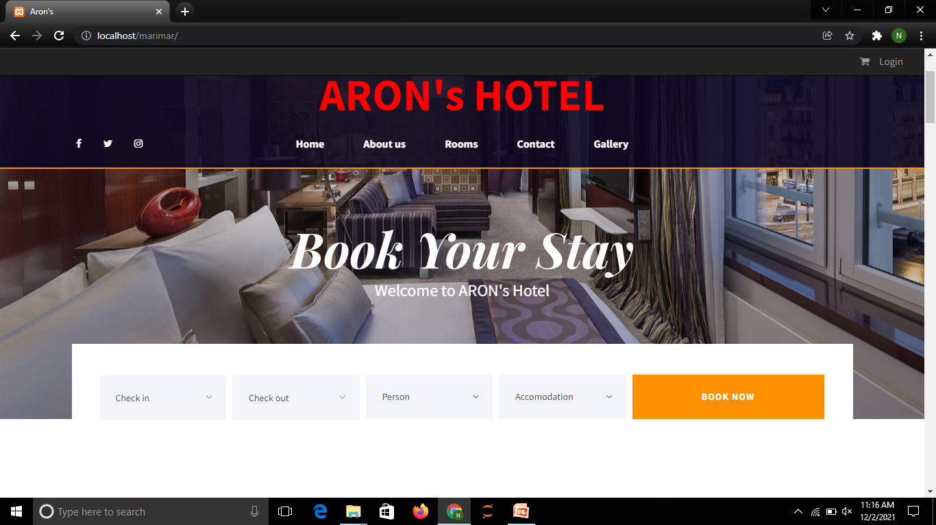
Project Title HOTEL MANAGEMENT

Slide 3
Introduction
Team Members:
Naman Sharma (191500476)
Rohit Kumar (19500671)
Sushant Gautam (191500833)
Ayush Parashar (191500199)

Slide 4
Outline
Background Details
Purpose
Application details
Requirements
Modules Description Application Description

Slide 5
Purpose:
To make a website for Tourists to stay in our hotel .
To provide a convenient way to book a room
Easy to find availability of rooms according to their needs
A storehouse of different type of rooms.

Slide 6
Advantages
a) Save time of Tourist as they can book online from anywhere
b) Easily appprochable for the user
c) User convenient
d) Different varieties of rooms according to the requirement

Slide 7
System Requirements:
Software Requirements.
Hardware Requirements.

Slide 8
1. Software Requirements:
SYSTEM SOFTWARE SPECIFICATION:-
• Technology Implemented : PHP
• Language Used : HTML, CSS, JAVASCRIPT
• Database : Firebase
• Web Browser : Chrome

Slide 9
2. Hardware Requirements:
• Processor : i3/i5/i7
• Operating System : windows10
• RAM : 512 Mb •
Hard disk : 100 GB
• Display : 1280*720

Slide 10
Contribution Summary
1. Rohit Kumar :- front-end and back-end developer
2. Naman Sharma :- Front-end Developer and Designer
3. Sushant Gautam:- Front-end Developer and Designer
4. Ayush Parashar:- Front-end Developer and backend developer

Slide 11
Module Descriptions:
Log in and Sign up
Create Account
About Us
Know more about us
Default fontend page
Book any room online according to needs
Different accomodations
Contact us through our Email

Slide 12
Default Display Page

Slide 13
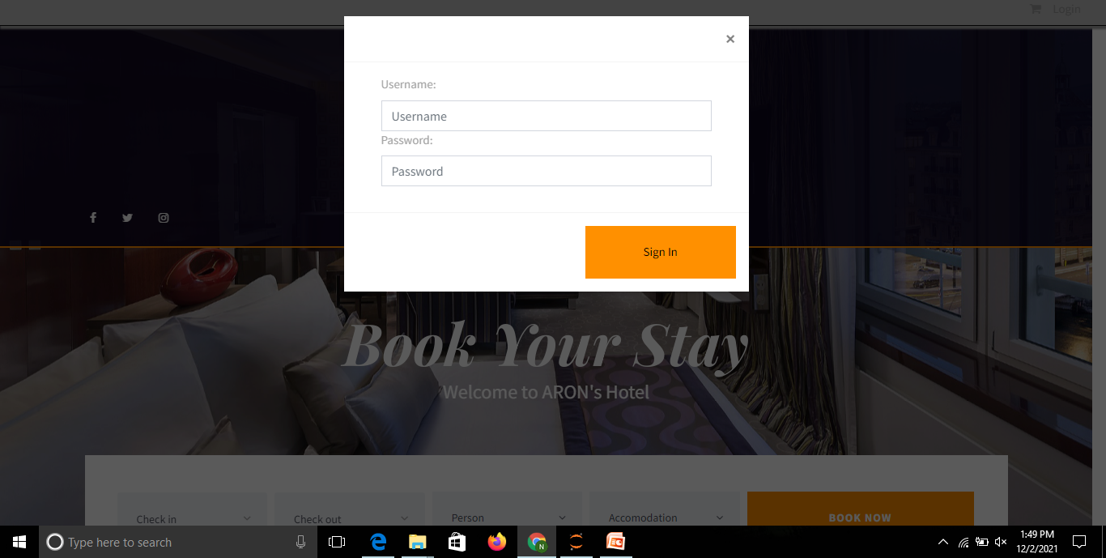
USER : LOGIN

Slide 14
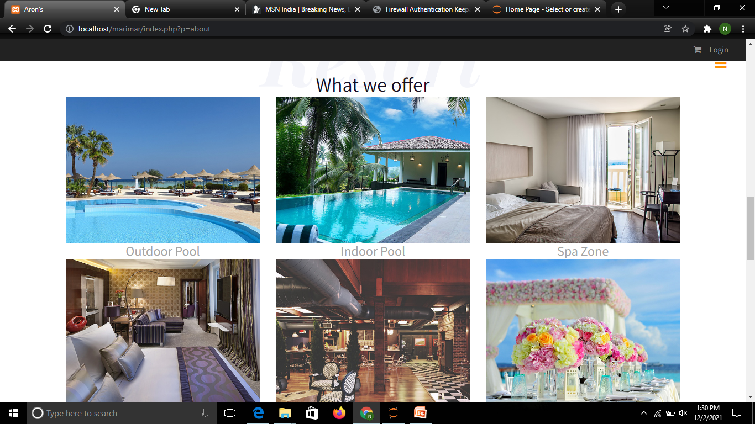
We Offer

Slide 15
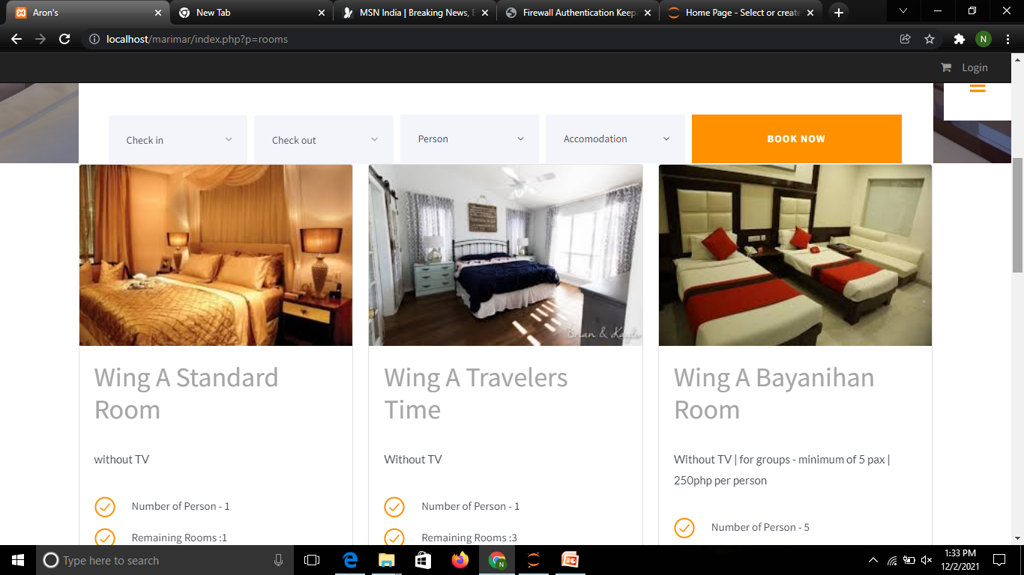
ROOMS

Slide 16
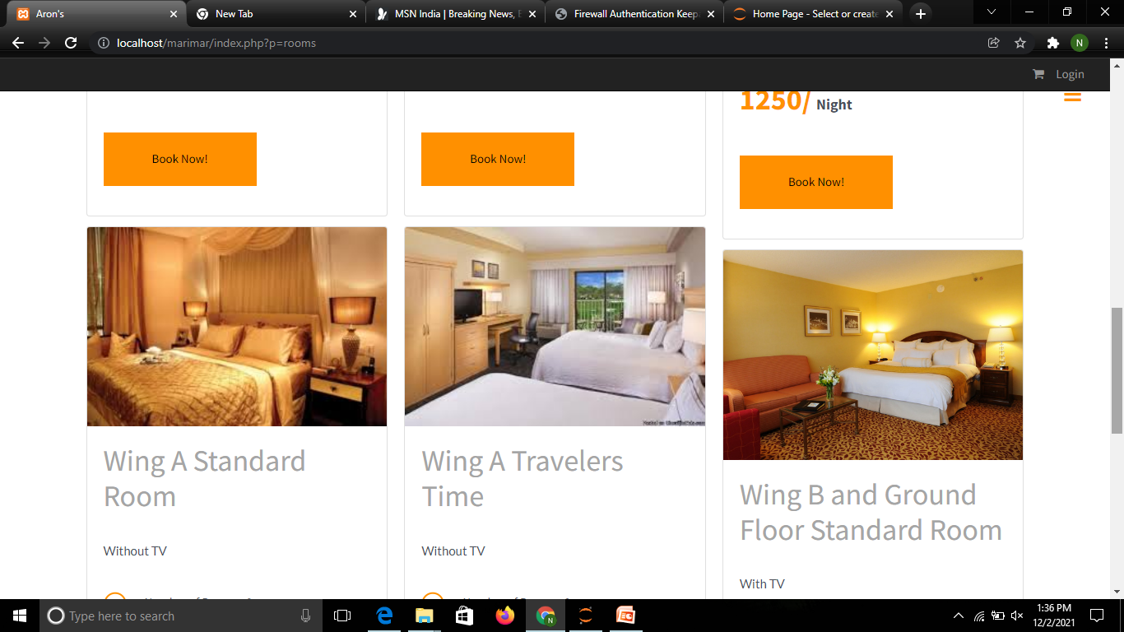

Slide 17
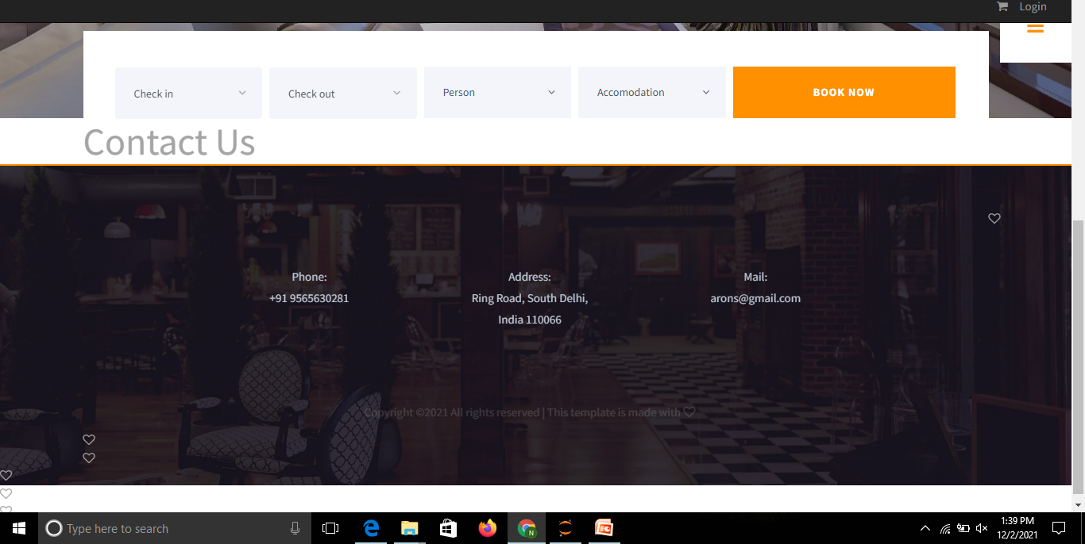
CONTACT US

Slide 18
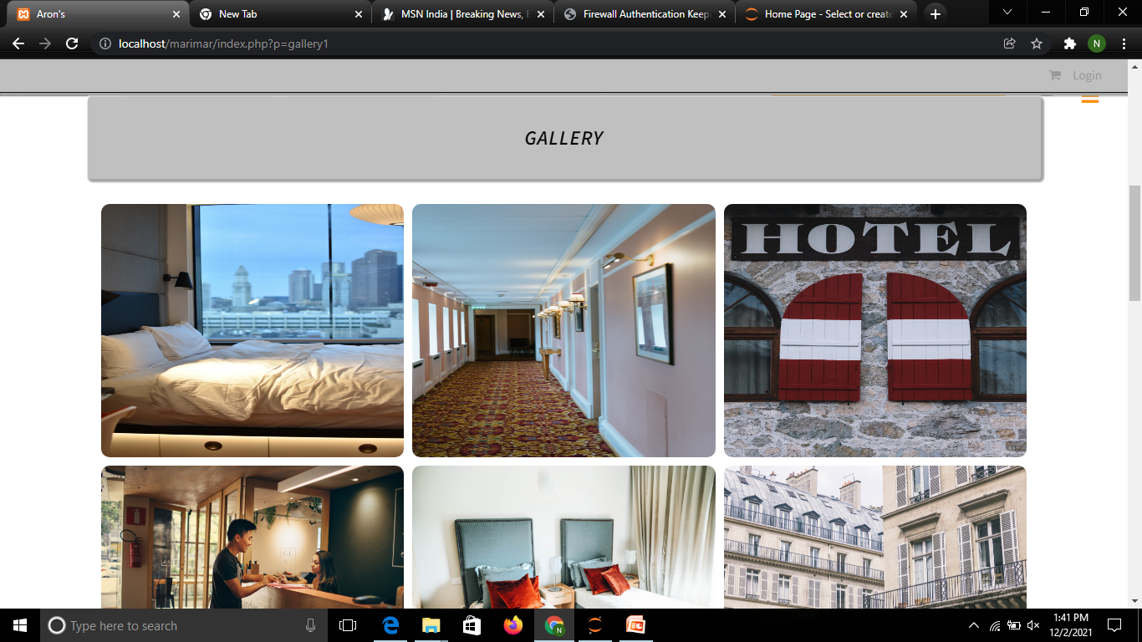
GALLERY

Slide 19
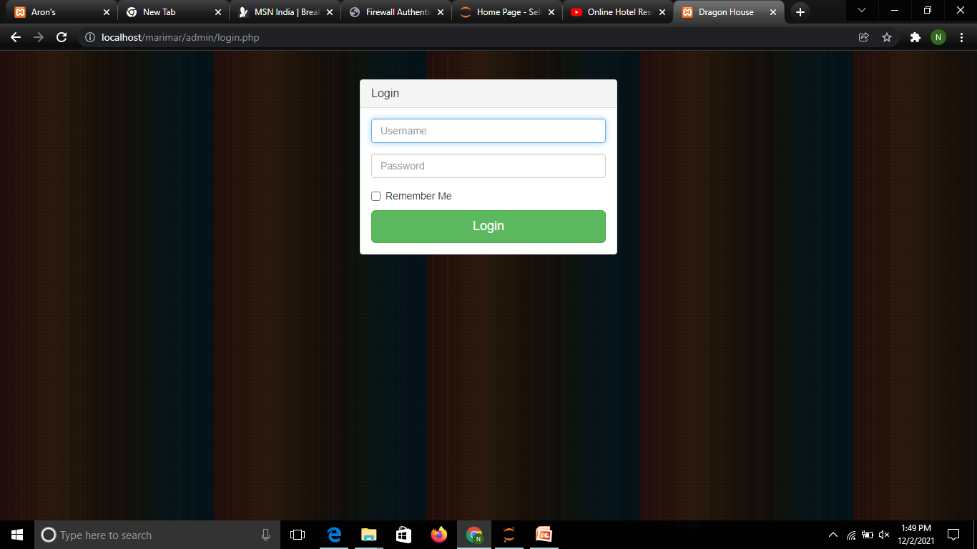
ADMIN : LOGIN

Slide 20
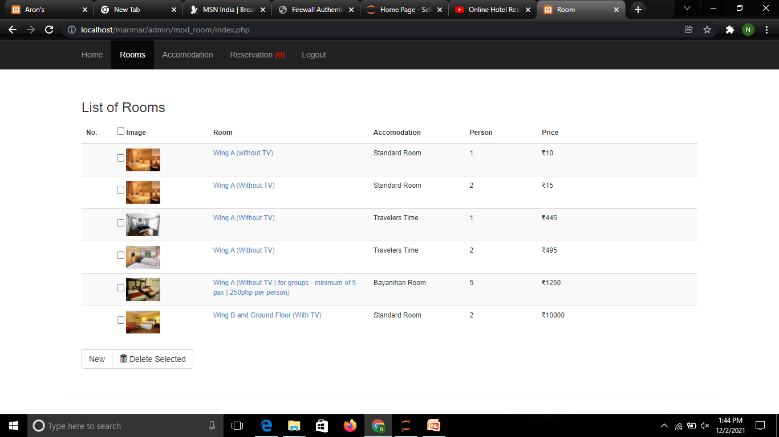
ADMIN PAGE : ROOMS

Slide 21
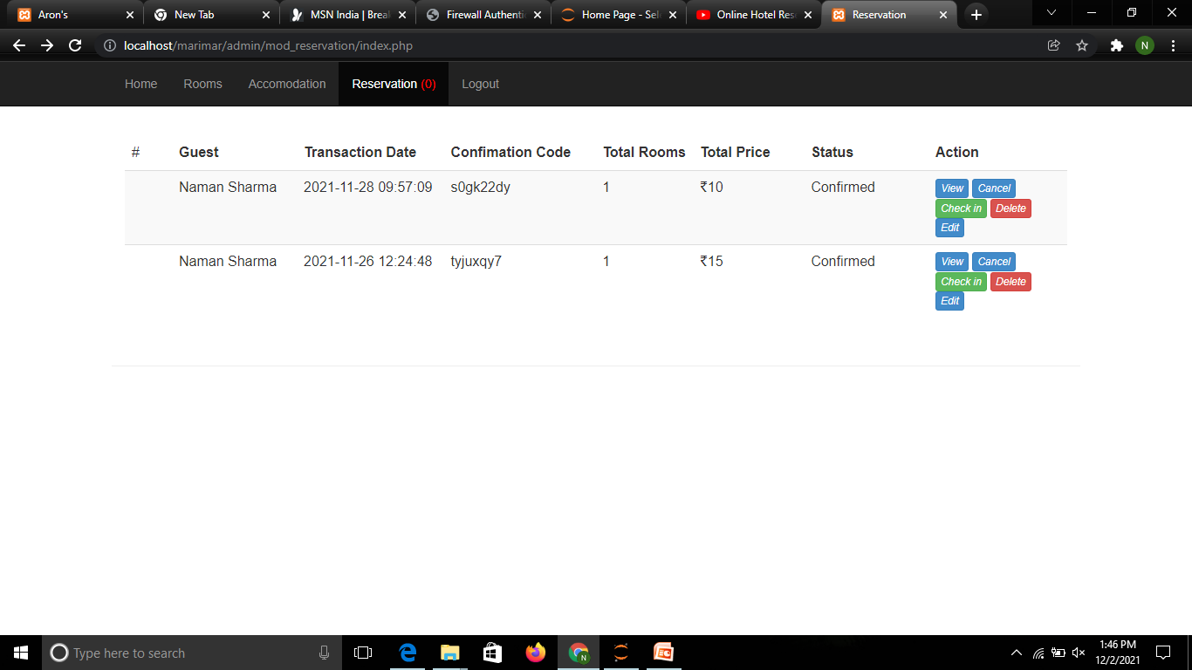
ADMIN : RESERVATION

Slide 22
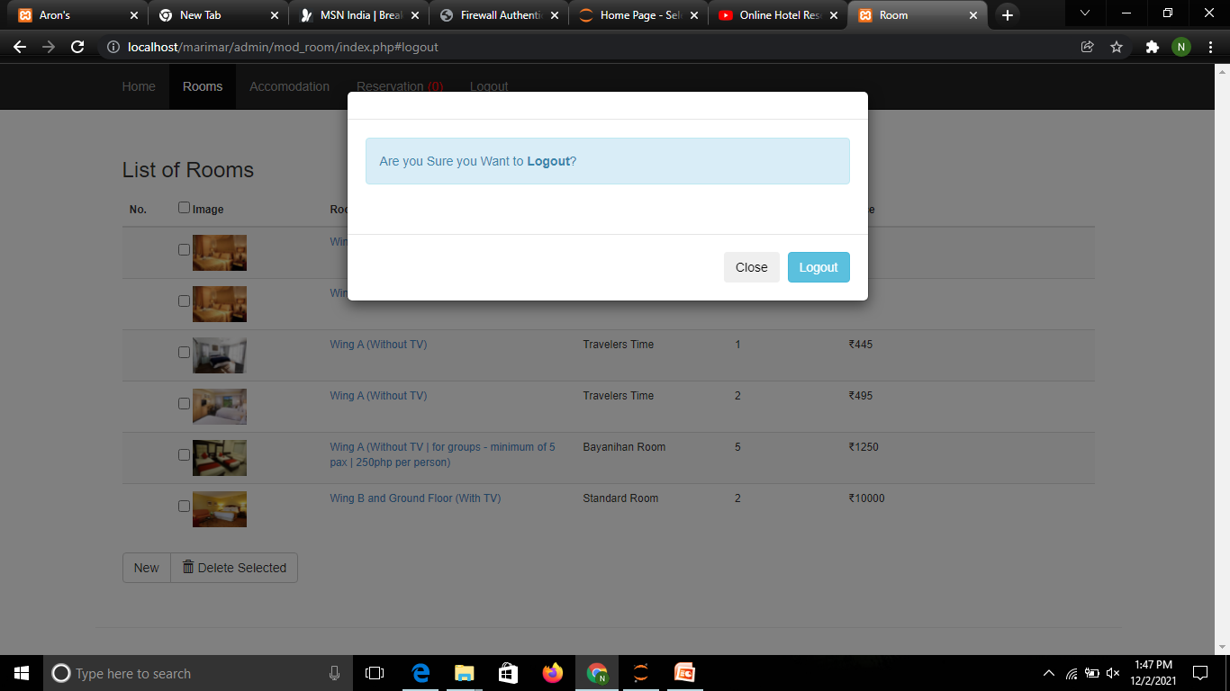
ADMIN : LOGOUT

Slide 23
Thank You

